Slide 1
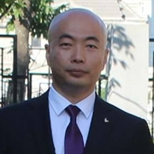
Ng04. Other Features
杨旭, 331335713@qq.com
公众号: 草根专栏

Slide 2
今天的内容
List
Infinite Scroll
CRUD
TinyMCE
File Upload
CDK Table

Slide 3

Day ng04
草根专栏

